Slide 1


Customer Segmentation for Retail
GROUP 8:SAHIL KAK,DEEPAK MATHIVANAN, NORMAN CHANG, APRIL 17 2025
PROFESSOR: SAEID (SAEID.ABOLFAZLI@UTORONTO.CA)

Slide 2
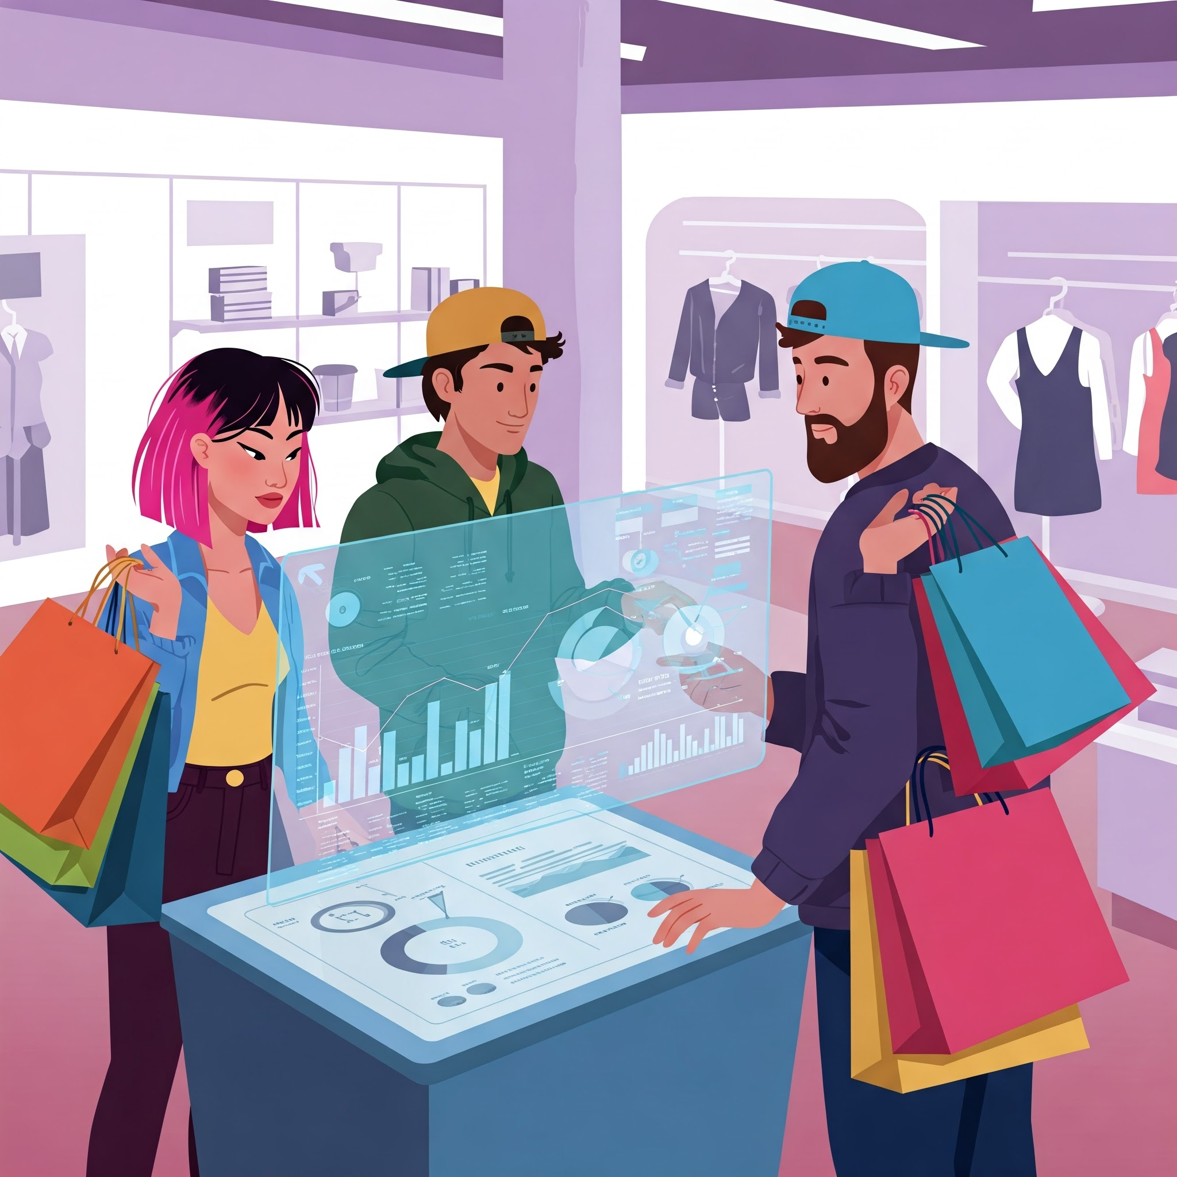
Introduction
Analyze and segment customer data for a UK-based online retail store to optimize marketing strategies.
Dataset contains transactions from December 2009 to September 2011.
Data exploration, preparation, transformation, and modeling using Python libraries (e.g., Pandas, Scikit-learn).
K-Means Clustering and RFV models applied to segment customers.
DBSCAN clustering applied for customer segmentation
Customer groups identified based on purchasing behavior.

Slide 3

Problem Statement
1 .Integrate Customer Relationship Management (CRM) with Analytics.
2 Gain deeper insights into customer behavior and preferences using RFM analysis.
3 Key Questions: Recency, Frequency, and Monetary Value of customer purchases.

Slide 4
Data Exploration

Slide 5
DATA EXPLORATION(EDA)
Display the number of unique values in each column using df[column].nunique() for each column.
Use df['Country'].value_counts() to see the distribution of transactions by country.
Determine Missing Values
Check for missing values using df.isnull().sum() to identify columns with missing data.
Identify unique values
Display the number of unique values in each column using df[column].nunique() for each column.
Transaction by Country
Use df['Country'].value_counts() to see the distribution of transactions by count
Transaction Over Time
Use df['InvoiceDate'].value_counts().sort_index() to analyze the distribution of transactions over time.

Slide 6
DATA PREPARATION
CustomerID as they are essential for analysis.
To enhance data quality, performance and accuracy, we utilized a number of techniques to transform the raw data into a clean and standardized dataset.
Handling missing values
Drop rows with missing CustomerID as they are essential for analysis.
Convert InvoiceDate to Datetime Format
Convert the InvoiceDate column to datetime format for easier manipulation
Detected and removed outliers using IQR(Interquartile Range)
Define lower and upper bounds to calculate IQR
Remove Negative Quantities and Unit Prices
df = df[(df['Quantity'] > 0) & (df['UnitPrice'] > 0)]

Slide 7
DATA TRANSFORMATION
A number of transformation techniques have been adopted to facilitating data models analysis and training.
Aggregation - Group the data by CustomerID and Country, and aggregate the total price and quantity.
Data Cleansing - Remove Invoice No which starts with 'c' because 'c' indicates a cancellation
Standardize the data - MinMaxScaler(K-means) & Standard Scaler(DBSCAN)
Dimensionality reduction(PCA)
Applied on top of scaled features and calculated variance

Slide 8
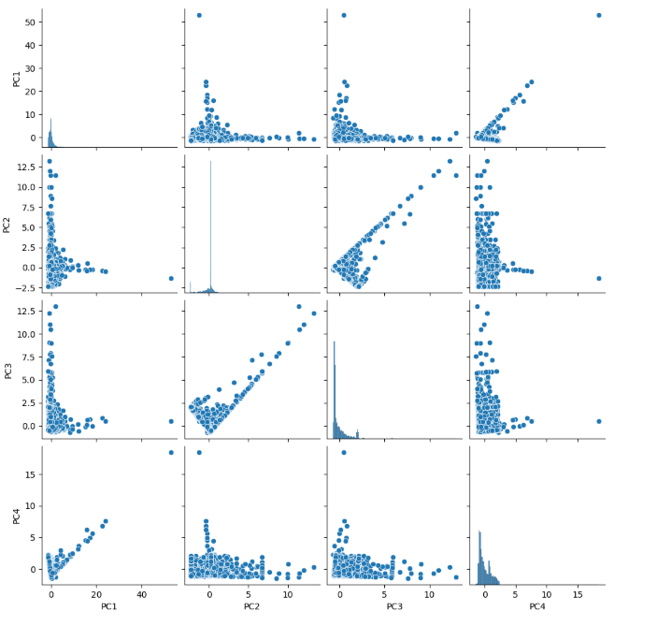
Data Visualization
Used pairwise scatter plot matrix to explore relationships and potential clusters among principal components
K-distance graph to identify the epsilons
Scatter plots with cluster labels
Bar plot charts to visualize the top spending customers, top country with more customers

Slide 9
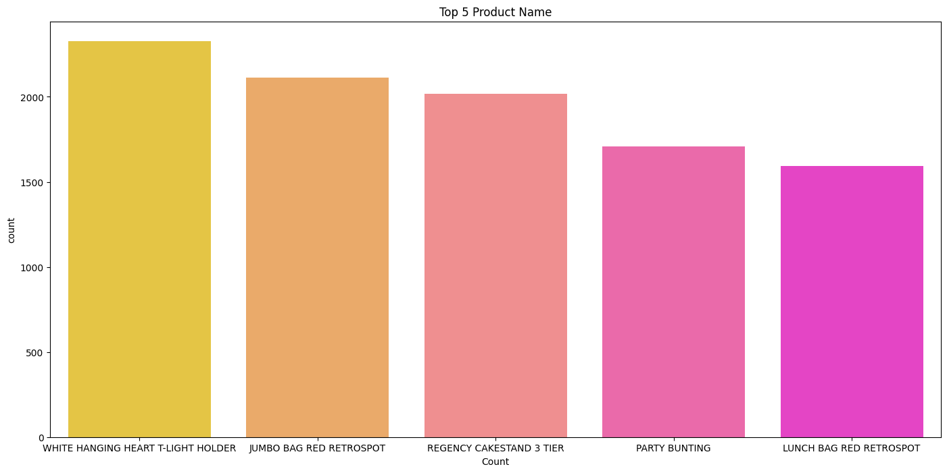
Top 5 Selling Products

Slide 10
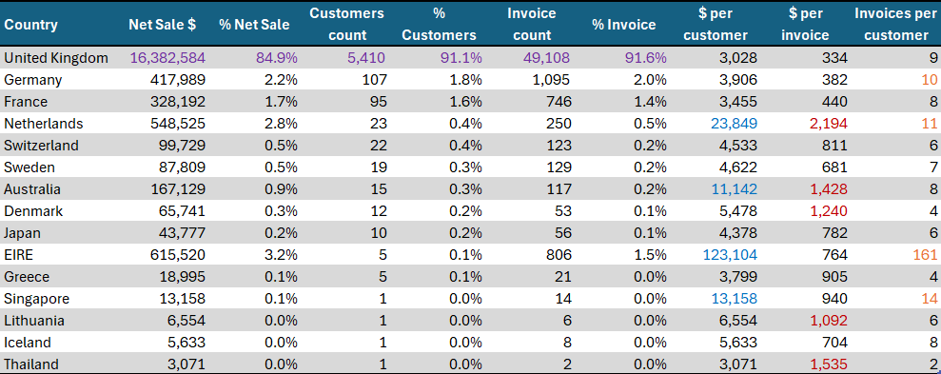
Countries -Highest number of customers

Slide 11
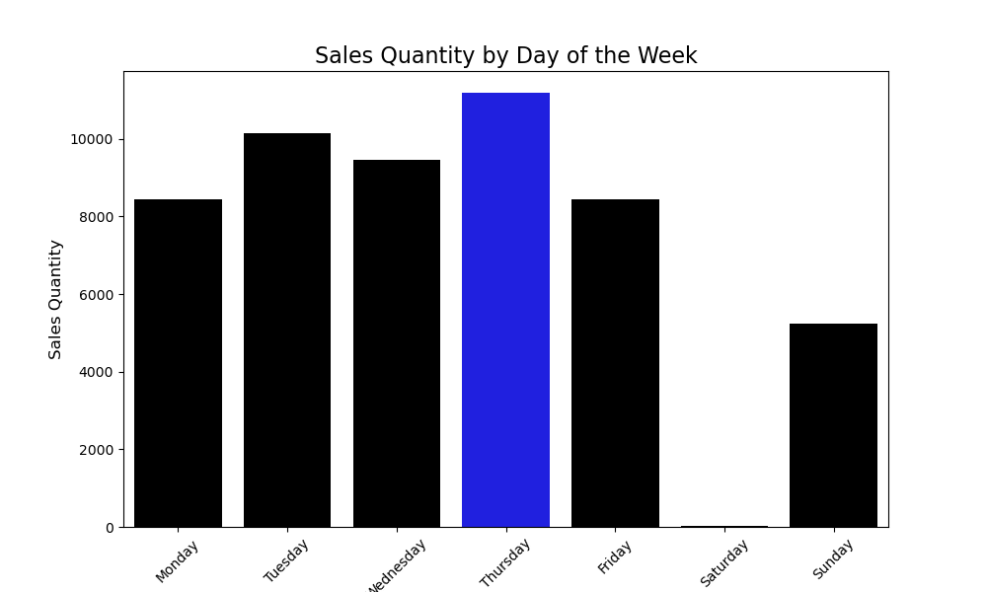
Sales Quantity By Day of Week

Slide 12
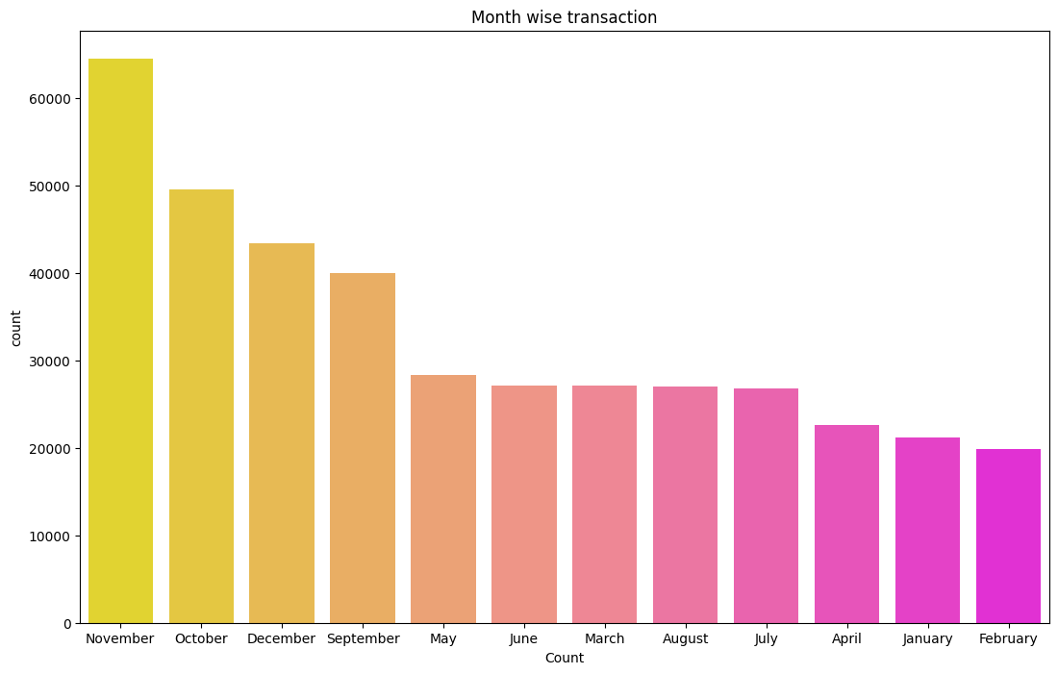
Month -Most and the least number of purchases

Slide 13



Methodology: RFM Analysis
Calculate RFM Values: Determine Recency, Frequency, and Monetary values for each customer.
Segmentation: Group customers based on RFM Scores.
Personalization: Tailor marketing strategies to specific customer segments.

Slide 14
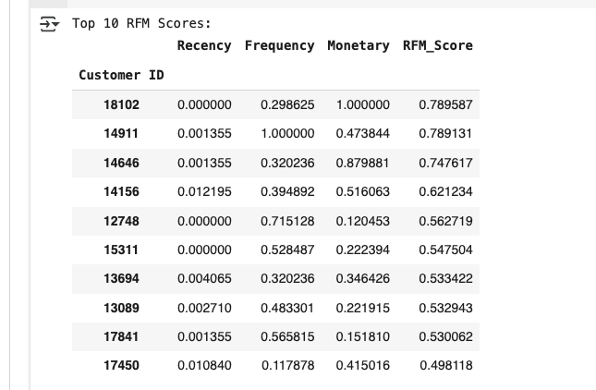
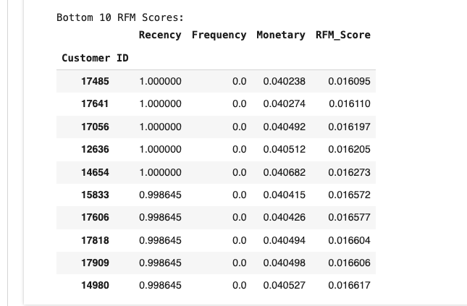
RFV Model Results

Slide 15
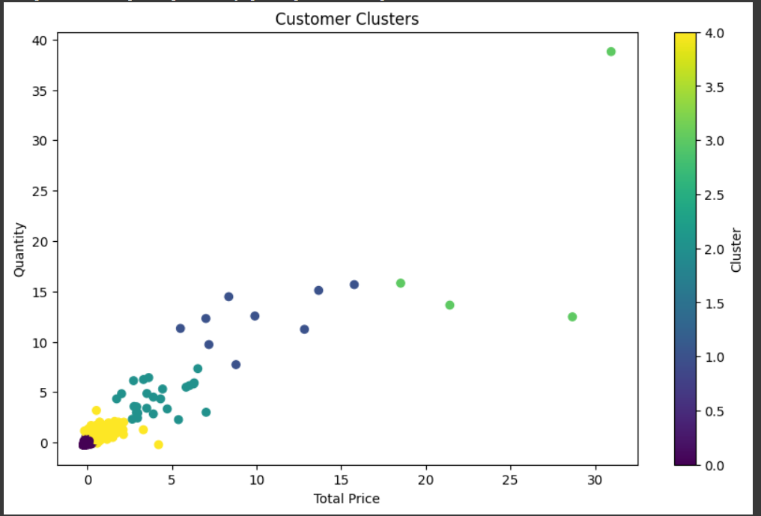
K-MEANS CLUSTERING
This is the cluster distribution pattern of our data. Since it is not a supervised model, training may not be available. No label is required but focus on discovering patterns. Cluster counter can be adjusted to achieve more accurate results.

Slide 16
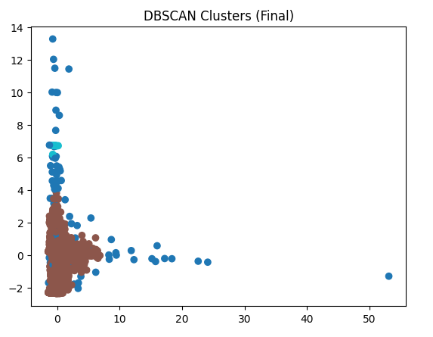
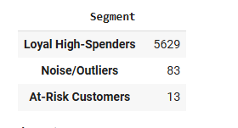
Density-Based Spatial Clustering of Applications with Noise
Unsupervised ML algorithm which doesn’t need number of clusters
Robust to Outliers
It is controlled by two key parameter epsilon and min_sample
Identified an array of epsilon using Elbow method(k-distance graph)
Based on the data used stricter heuristic method(dimension * 2)
PCA(variance ratio) did on top of RFM to identify the features weightage
Total variance - 0.9684656897010425
Silhouette Score for the array of epsilons(0.8 - 0.75 & 0.9 - 0.75)
Project web page - https://deepakmathivanan.github.io/uft-termproject/

Slide 17
Conclusion
Exploratory Data Analysis Unveiled:
Top Products Drive Revenue
Examples: “White Hanging Heart T-light Holder,” “Jumbo Bag Red Retrospot”
Focus on restocking top performers; reevaluate 108 low-performing SKUs (threshold: $738)
🌍 Geographic Insights
UK dominates in sales and customer base
High-potential regions:
Ireland: Avg. $123K spend per customer, 161 invoices
Netherlands: Avg. $2K per purchase → Focus on expanding these markets
👥 Customer Behavior & Engagement
Revenue heavily influenced by top customers
Opportunities for:
Loyalty programs
Targeted discounts
Strategic relationship management
🕒 Sales Timing Patterns
Peak Sales: Thursdays, 12–3 PM
Align promotions & staffing for mid-to-late week surges
📅 Seasonal Trends
Sales spike in Oct–Dec due to holidays
Plan campaigns & stock accordingly

